Slide 1
InCUS Summary
(Invitational Conference on USMLE Scoring)
Zucker School of Medicine | February 2020
Notes:
Did it need to be in the previous format?

Slide 2
Preparation & testing creates curricular pause for US MD students
80% of US MD students prep > 6 weeks; some prep 12-16 weeks
USMLE Step 1 with increasingly outsized role in residency screening and selection
Med School Perspective....
Feeling of a misaligned “parallel curriculum” around Step 1 prep
Impact on attendance / volunteerism / small group work
Step 1 role in medical specialty selection & career direction
Students’ limited ability to differentiate via other metrics is limited
Concerns over role of high stakes exams and impact on student well- being
Notes:
Anecdote: problem with students not in class so UVM calls this a capstone study course
Students are supplying about 90 apps on average to programs

Slide 3
Increase in Number of applicants (MD, DO, and IMG) has outpaced increase in GME slots
USMLE Step 1 with increasingly outsized role in residency screening and selection
Residency Perspective...
Increase in number of applications/student
Continues to rise
MD schools are increasingly pass/fail,
less often rank order students,
more varied curricula
Communication about student performance in medical School
Standardized exam performance important for program accreditation
Notes:
Anecdote: problem with students not in class so UVM calls this a capstone study course
Students are supplying about 90 apps on average to programs

Slide 4
Numeric (3-digit) USMLE score reporting
Pro
Highly reliable, objective assessment of relevant competencies
Con
Standardized test scores do not fully predict performance
Medical schools may have challenges with assessment.
National standard
Focus on maximizing scores negatively impacts student well being
Race for scores hinders medical education innovation
Can contribute to lack of diversity in medicine
Changes may stress an already challenged transition system (disruption)
No other standardized assessments across UME
Licensure only requires a P/F outcome
What is measured, matters: “basic science matters”
Only assesses foundational science knowledge and application of that knowledge
Keeps competing tests out
Notes:
Key drivers list…
Student wellness
Need for common standard
Fairness/equity
Minimizing disruption
Making incremental change to improve overall system
Need for objective screening tool for res selection

Slide 5
InCUS—invitational Conference on USMLE Scoring. March 2019
InCUS GOAL
Sponsoring Organizations:
AAMC, AMA, ECFMG, FSMB, NBME
65 Attendees (20 staff, 45 guests)
Regulators
Stakeholders (including learners)
Diversity within each
Collaboratively review the USMLE program’s practice of numeric score reporting within the context of its primary use of licensure, and to discuss any secondary uses and the broader regulatory and educational environments in which USMLE exists!

Slide 6
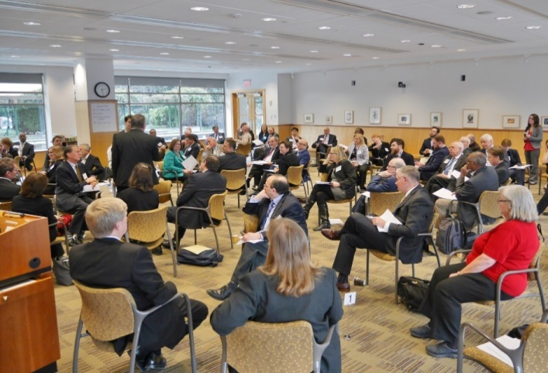
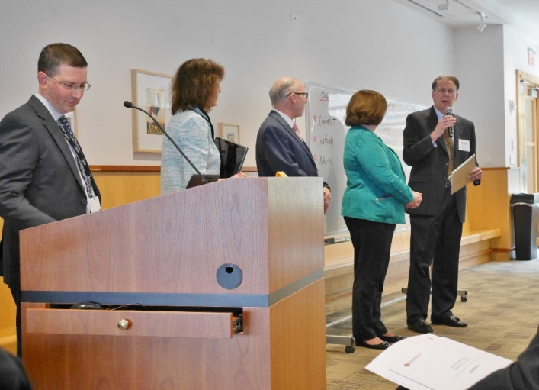
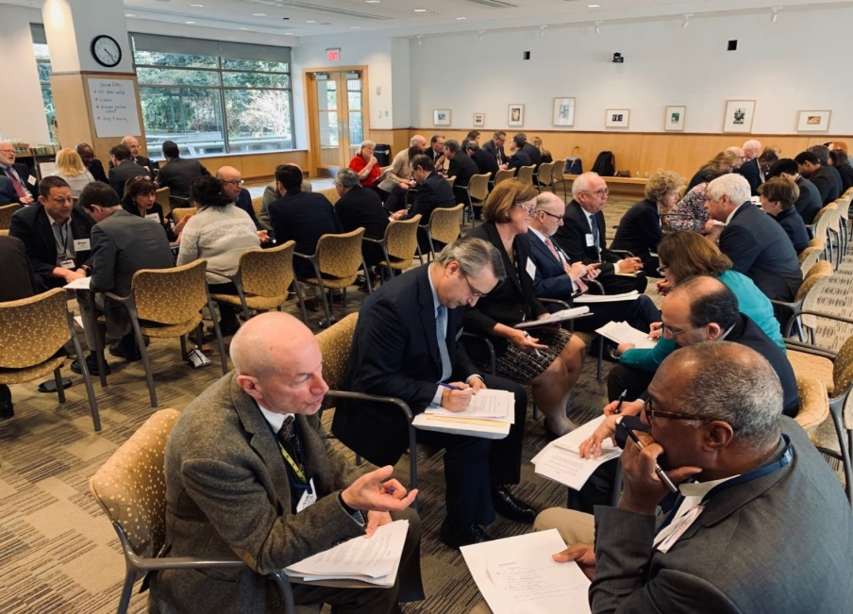
InCUS Meeting - March 2019
CONNECT
INFORM
ADVISE
Not a decision making meeting.

Slide 7
InCUS Areas of consensus
Current UME-GME transition is flawed. Each stakeholder group has optimized their part of the system over time.
Unilateral changes to USMLE will not “fix” the system, absent changes in other parts of the system.
Changes—both systemic and specific to USMLE—must be explored, identified and implemented on a reasonable timeline.
On the problem, not the solution(s)
Notes:
These consensus center on the problem or its identification…consensus on solutions is more challenging.
No clear consensus even within stakeholder groups

Slide 8
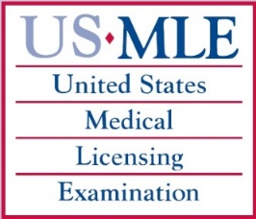
InCUS Recommendation
1
2
3
4
Consider score reporting changes, e.g., pass/fail; composite score; categorical/tiered scoring
Research on how USMLE is (or is not) related to performance in residency and/or practice
Continue work to address group (racial/ demographic) differences in USMLE
Undertake comprehensive overview of UME-GME transition system

Slide 9
Intensive, Iterative Engagement and Communication strategy
Dedicated InCUS website created
Literature review plus other communications
Pre-meeting solicitation of commentary from 200 organizations
Post-meeting
Open period of review of draft recommendations
Six podcasts
Multiple presentations by planning committee to associations, schools, etc.
News stories in planning committee association media (AAMC news, etc)

Slide 10
Rec 1: Consider score reporting changes, e.g., pass/fail; composite score; categorical/tiered scoring
Very positively 27%
Positive 8%
Neutral 2%
Negative 9%
Very negatively 53%

Slide 11
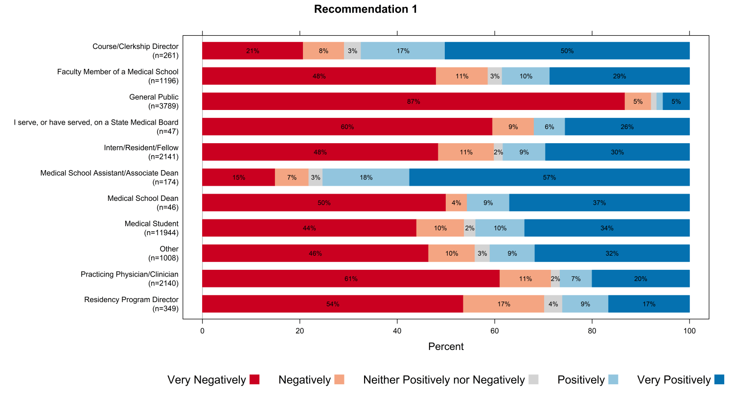
Rec. 1: Consider other score reporting options

Slide 12
Rec 4: Undertake comprehensive overview of UME-GME transition system
Very positively 29%
Positive 22%
Neutral 13%
Negative 12%
Very negatively 26%

Slide 13
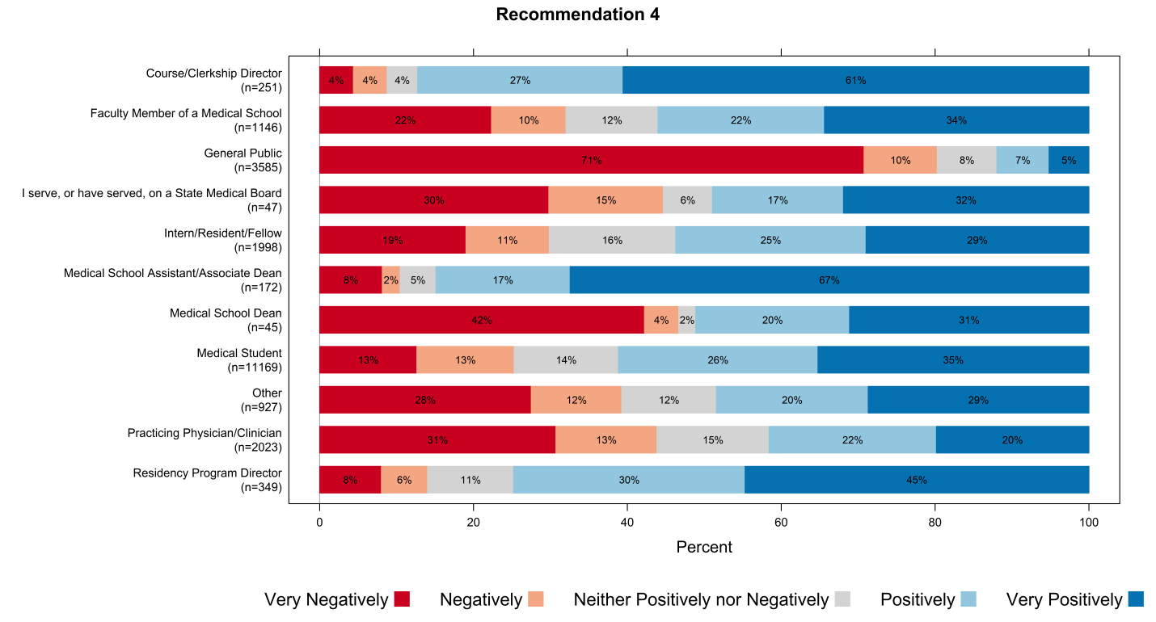
Rec. 4: Systemic change

Slide 14
Areas of potential exploration
Improve application process
Reduce # of applications submitted by applicants
Improve transparency of UME-GME transition process
Identifying potential adjustments to the Match
Improving Program Directors’ ability to more holistically review applicants
Improving trust/transparency of medical school-based assessments
Reviewing role of standardized testing in UME-GME transition
Develop assessment(s) for other important measures beyond knowledge
All changes must consider and support
workforce diversity

Slide 15
Comments: UME-GME transition
Students & Residents attending InCUS
“The health and wellness of students and physicians-in-training is at stake. The current system of UME-GME transition, of which USMLE is a part, is harming people, and we have a responsibility to address this.”
“Indeed, in the absence of other action, a change to P/F or tiered scoring could lead to a period where residency selection committees…would be left with non-equivalent metrics among students, and no obvious way to parse an ever-growing number of applications.”
“ We acknowledge that is it inappropriate to state that a change to USMLE scoring alone will solve the challenge.”
Notes:
Who are these quotes from?

Slide 16
USMLE “Pro/Con” Debate
InCUS Planning Begins
January 2019
March 2018
May 2018
2018
Coalition Accepts Charge
USMLE Step 1 Announcement / Planning Committee Appointed
InCUS Meeting
Coalition Approves Proposals
March 2019
September 2019
December 2019
February 2020
2019
Planning Committee Meeting
Coalition Reviews Planning Committee
January 2020
March 2020
April 2020
2020
Review Committee’s Report Due
USMLE Step 1
Score Changes
January 2022
April 2021
2021

Slide 17
Questions?

Slide 18
Interconnectedness of USMLE in Education/Regulation
Initial medical licensure
Primary/
Intended
USMLE
Promotion / graduation
Accreditation metric
GME
Screening / selection
Curriculum feedback
UME
Secondary/
Envisioned
Secondary/
Unanticipated and growing
Notes:
Points of emphasis
USMLE’s primary purpose; as well as the 2nd uses both anticipated and unanticipated

